Slide 1

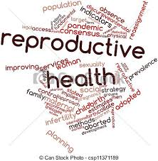
Class 12
Reproductive health

Slide 2
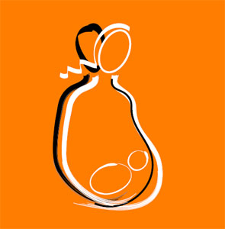
What is reproductive health…?
It is the state of physical, emotional, behavioral and social fitness for leading a reproductive life.
According to WHO: A total well being in all aspects of reproduction, i.e., physical, emotional, behavioral and social

Slide 3
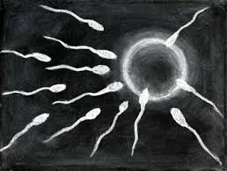
Reproductive Health- Problems & Strategies
India was among the 1st countries to initiate actions & plans to attain total reproductive health as social goal.
These programs are called as ‘ FAMILY PLANNING’-initiated in 1951.

Slide 4

Improved programs covering reproduction related areas are in operation- ‘Reproductive & Child Health Care Programs’ (RCH)
Create awareness about various reproduction aspects & provide facilities and support to build reproductively healthy society

Slide 5
POPULATION EXPLOSION AND BIRTH CONTROL
The increase in size and growth of human population is called population explosion.
Indian population- 350 million at independence and crossed 1 billion in May 2000
Alarming growth rate- scarcity of basic requirements (food, shelter & clothing)

Slide 6
The reason for high population explosion are,
Decline in death rate.
Longer life span.
Decline in maternal mortality rate (MMR)
Decline in infant mortality rate (IMR)
Some religious belief against birth control.
Lack of reproductive health knowledge.

Slide 7
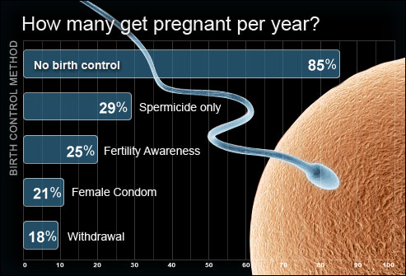

Slide 8
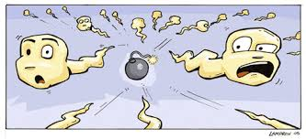

Contraception
Contraception aims to control birth, by using contraceptives
Prevention of conception or fertilization of ovum during sexual inter course is called contraception.
An ideal contraceptive should be user- friendly, easily available, effective and reversible with no or least side effects

Slide 9
The different types of contraceptives are:
Natural / Traditional method
Barrier method
Intra uterine device [IUD’s]
Oral contraceptives
Injection and implants
Surgical method

Slide 10
. Natural methods:
It work on the principle of avoiding chances of ovum and sperms meeting.
a) Periodic abstinence:
b) Withdrawal or coitus interruptus:
c) Lactational amenorrhea:

Slide 11

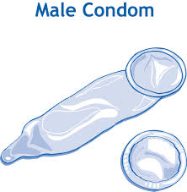
Physical contraceptive or Barrier methods:
This method prevents contact of sperm and ovum by barrier.
Available both for male and female.
a) Condoms:
Barriers made of thin rubber/ latex sheath, self inserted & disposable
Covers penis in male & vagina and cervix in female. It is used so that semen do not enter the female reproductive tract.
It also prevents AIDS and STDs.

Slide 12
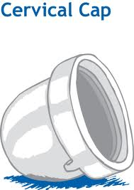
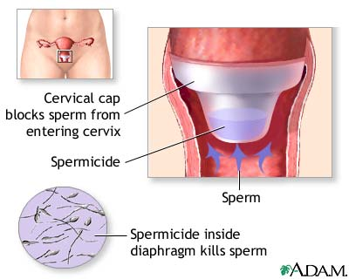
b) Diaphragm, cervical caps and vaults:
Barrier, made of rubber latex.
Inserted into the female reproductive tract to cover the cervix
Block entry of sperm through cervix, reusable
Spermicidal cream, jellies, foams along with these barriers

Slide 13
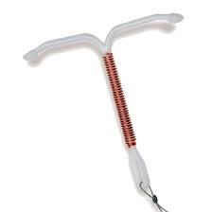
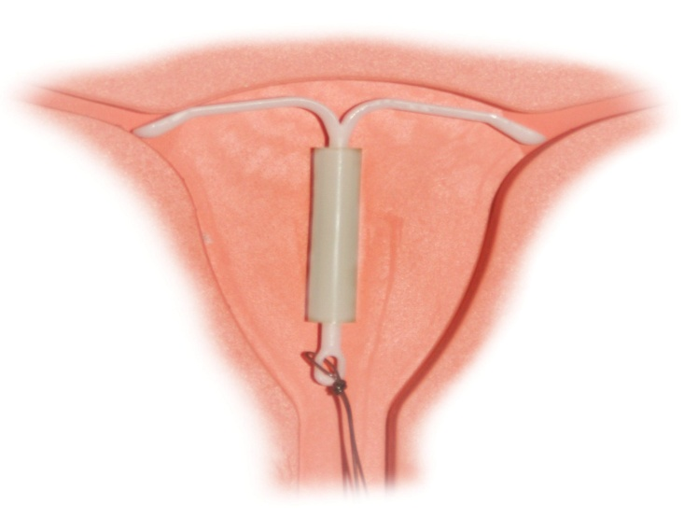
Intra Uterine Devices (IUDs )
These devices are only used by female
Inserted by doctor or nurses in the uterus through vagina.
They are available as:
Non-medicated IUDs e.g. Lippes loop: Phagocytosis of sperm
Copper releasing IUDs (CuT, Cu7, Multiload 375):
Cu ion released suppresses sperm motility and fertilizing capacity of sperm.
IUDs increases phagocytosis of sperm within the uterus.

Slide 14
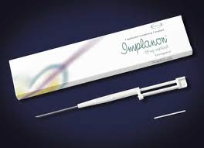

Injections or implants:
Progesterone alone or in combination with estrogen used as injections or implants under the skin of female.
Action similar to pills, effective for long periods
Progesterone or combination of progesterone and estrogen or IUDs- within 72 hours of coitus are effective as emergency contraceptives to avoid possible pregnancy due to rape or unprotected intercourse

Slide 15
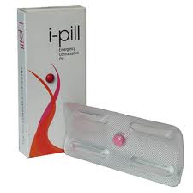
Emergency contraceptives:
These methods are used within 72 hours of coitus, casual in unprotected intercourse.
Administration of progesterone or progesterone-estrogen combination.

Slide 16
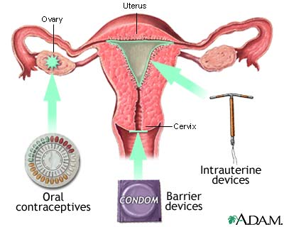

Slide 17
Surgical methods:
It is also called as sterilization method advised to male/ female partner to prevent any future pregnancy.
Blocks gamete transport, thus prevent conception
Sterilization in male is called-vasectomy & female- ‘tubectomy’
Vasectomy- a small part of the vas deferens is removed or tied up through incision made on scrotum

Slide 18
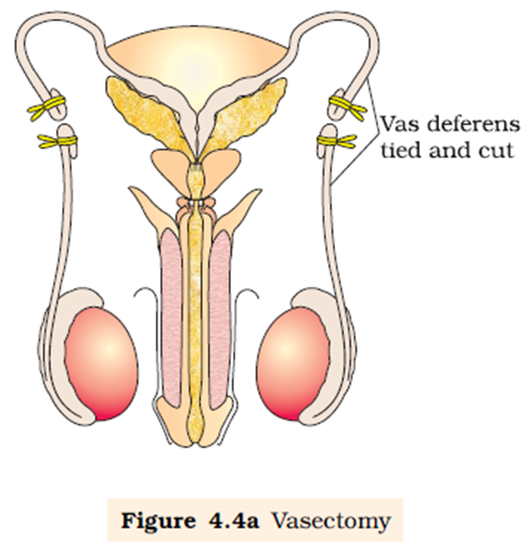
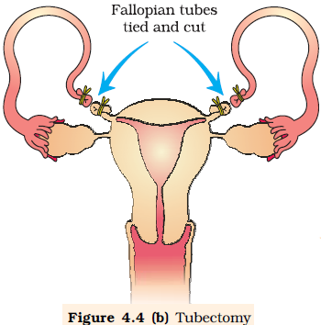

Slide 19
SEXUALLY TRANSMITTED DISEASES (STDs)
Diseases or infections which are transmitted through sexual intercourse are called Sexually transmitted diseases (STDs)/ Venereal diseases (VD)/ Reproductive tract infections (RTI)
Gonorrhea, Syphilis, Genital herpes, Chlamydiasis, genital warts, Trichomoniasis, hepatitis-B and HIV

Slide 20
Mode of transmission- Hepatitis- B & HIV
Sexual contact with infected person
Sharing of injection needles
Sharing the unsterilized surgical instruments
Transfusion of blood from infected person to healthy person
Infected mother to foetus
Except hepatitis-B, genital herpes and HIV infections, others are curable.

Slide 21
INFERTILITY
The couple unable to produce children in spite of unprotected sex is due to Infertility. Problems of infertility may be in male or female.
The reason of infertility may be:- physical, congenial, diseases, drugs, immunological or even psychological.
Female are blamed often in India
Specialized Health care units like Infertility clinics- diagnose, corrective treatments to have child
When treatments are not enough, couple are assisted with techniques called assisted reproductive technologies (ART)

Slide 22


